Slide 1


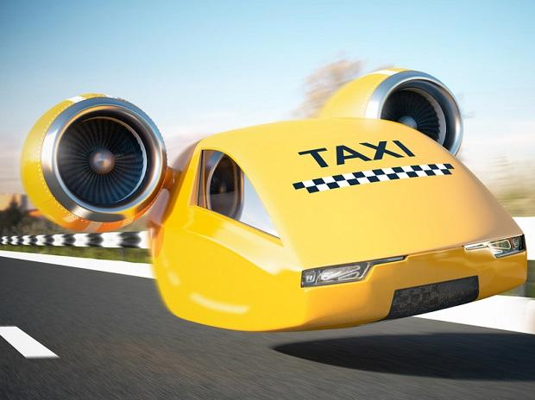
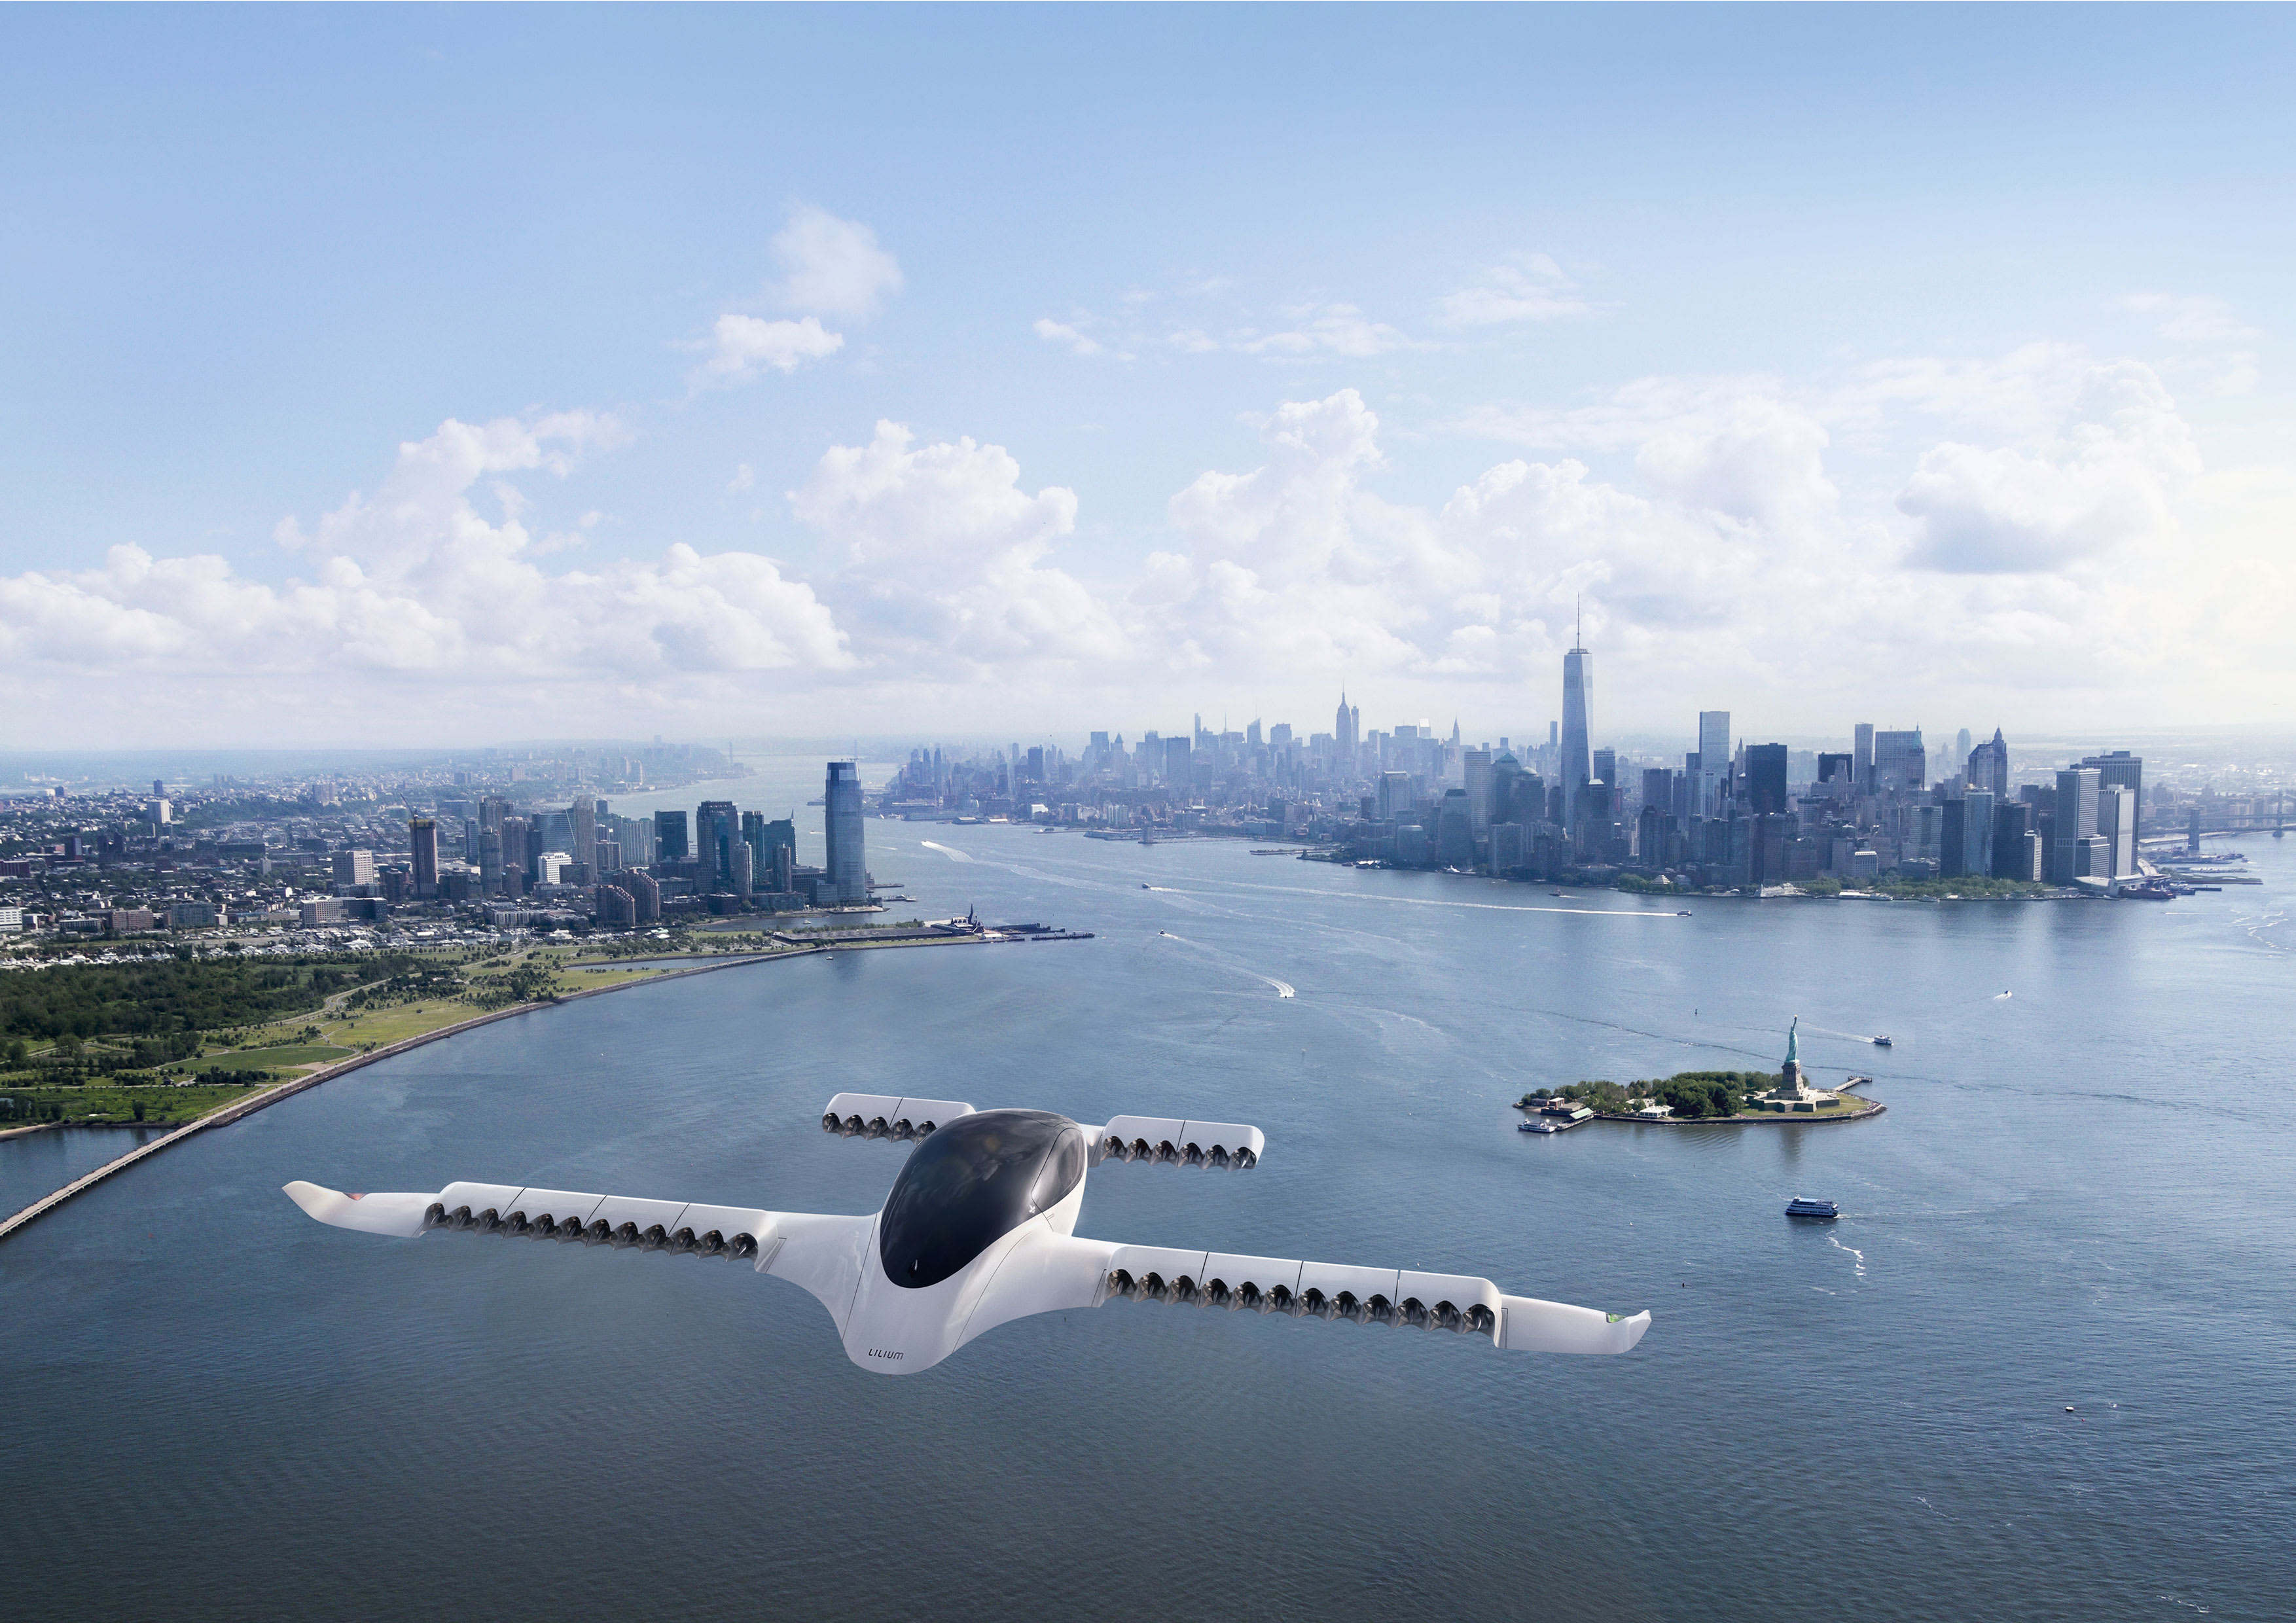
Applying Iterative Design Principles to a Live Product
Name: FREDERICK A. ZORETA
Date: DEC 15, 2020

Slide 2
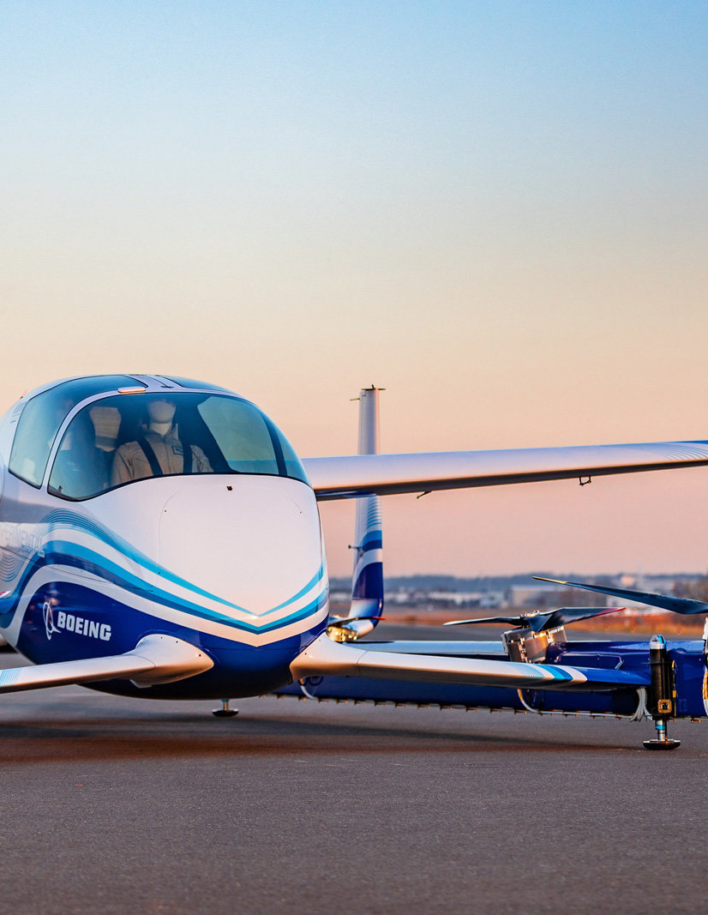
Step 1
Select KPIs
&
Evaluate Previous Multivariate Experiment Results

Slide 3
Select KPIs for Flyber Analyses
For the data available, which KPI(s) best match Flyber’s business model?
**Both the first 2 bullet points are answered with same response.
There are several KPIs that comes to mind that truly matches Flyber’s business goals.
# of users daily -> this could be derived by having a ‘COUNT DISTINCT’ of the rides per day
The Frequency of rides per neighbourhoods - > this be derived by getting the over-all tally of rides per neighbourhood and then getting both the SUM() and AVG()
The AVG # of a ridea(Daily) - > derived by simply getting the AVG() of rides within the entire dataset on a daily basis
The AVG # of a rides(Weekly) - > derived by simply getting the AVG() of rides within the entire dataset on a weekly basis
The AVG # of a rides(Monthly) - > derived by simply getting the AVG() of rides within the entire dataset on a monthly basis
The AVG # of a rides(Quarterly) - > derived by simply getting the AVG() of rides within the entire dataset on a quarterly basis

Slide 4
KPI Selections : Continuation
How would you calculate these KPI(s) using the available event data logs?
# of users daily -> this could be derived by having a ‘COUNT DISTINCT’ of the rides per day
The Frequency of rides per neighbourhoods - > this be derived by getting the over-all tally of rides per neighbourhood and then getting both the SUM() and AVG()
The AVG # of a rides(Daily) - > derived by simply getting the AVG() of rides within the entire dataset on a daily basis
The AVG # of a rides(Weekly) - > derived by simply getting the AVG() of rides within the entire dataset on a weekly basis
The AVG # of a rides(Monthly) - > derived by simply getting the AVG() of rides within the entire dataset on a monthly basis
The AVG # of a rides(Quarterly) - > derived by simply getting the AVG() of rides within the entire dataset on a quarterly basis

Slide 5
KPI Selections: Continuation 2
List other KPIs that might be important to Flyber but are not calculable based on available data:
1. I would focus on qualitative data. This would come in the form of results yielded from UX research & surveys. Some of these are:
‘On a scale of 1 to 10, 10 being the highest. How satisfied are you with Flyber’s services’?
Another qualitative question:
2. Are you highly likely to recommend Flyber to your family,friends and/or colleagues? If Yes, why? If No, we’d like to know where to improve.
Quantitative metrics:
3. The AVG wait times for passengers since a Flyber driver/pilot acknowledges (ACK) the ride_request
4. The AVG ride cancellations per: day/week / month/quarterly
5. The AVG Duration of rides per: day/weekly/monthly/quarterly

Slide 6
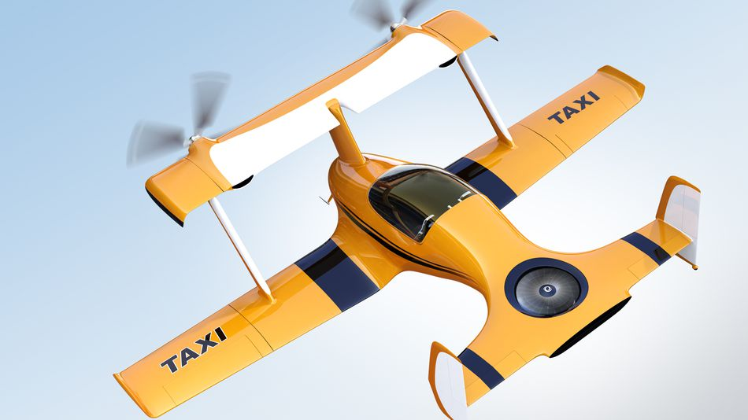
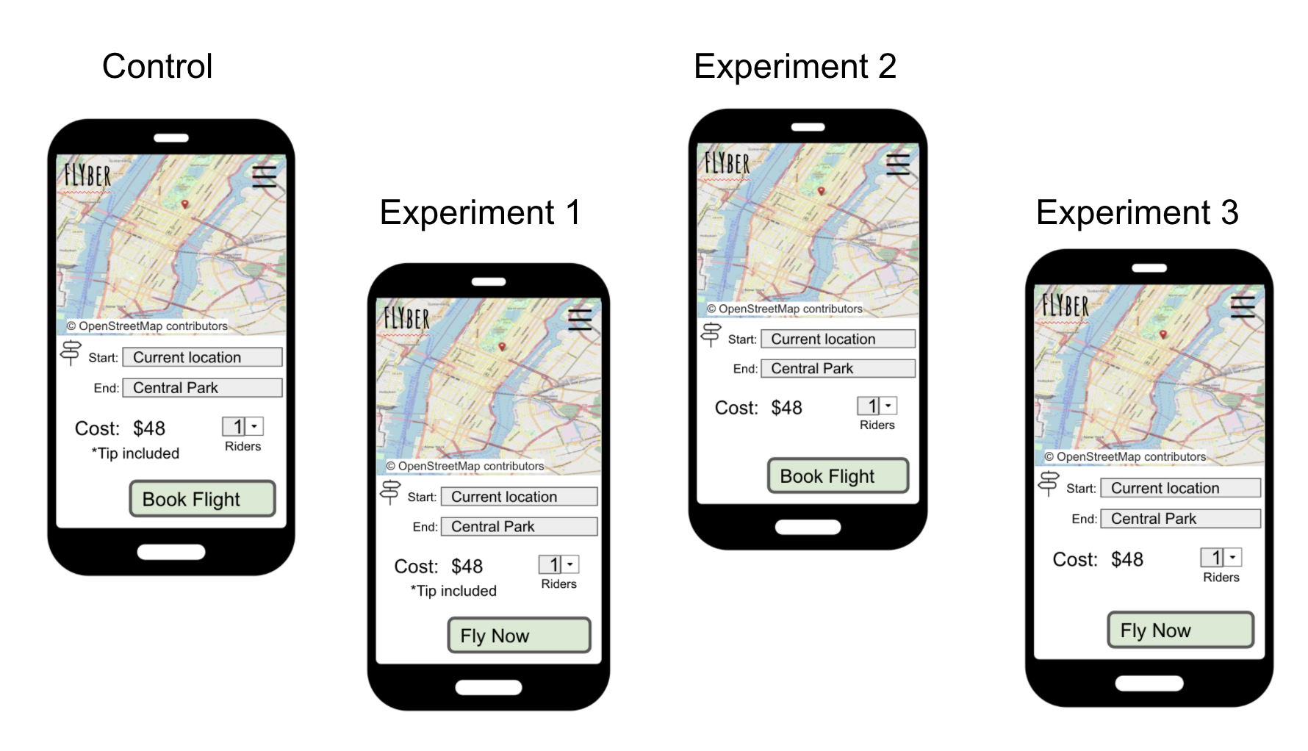
Describe the First Multivariate Experiment
Describe the elements tested during the multivariate experiment. You can use the image below when referencing the tests

Slide 7
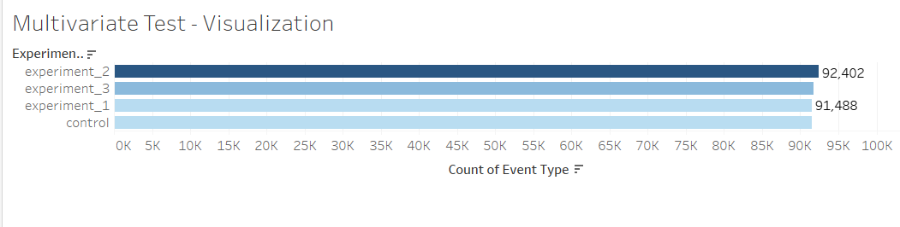
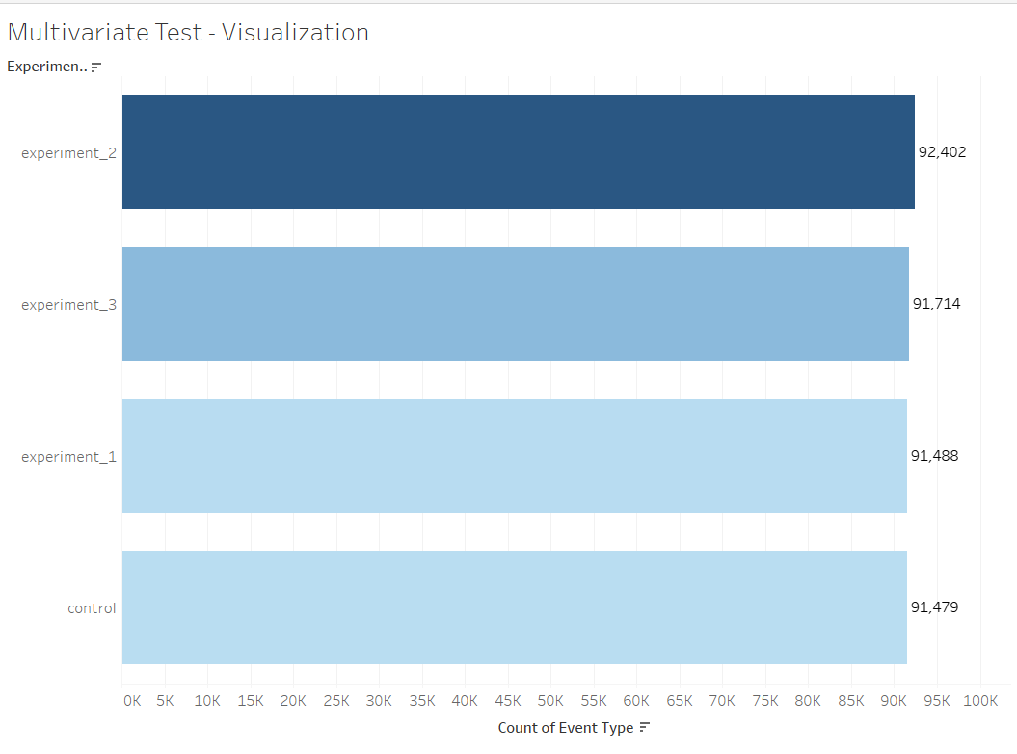
Review Multivariate Test Results: Visualization
Provide a visual representation of the impact of the experiment on the conversion rate of users booking a flight (out of all users opening the app)

Slide 8
Review Multivariate Test Results: Significance Test
Determine if there was a significant difference between the experiments and control states.
Explain how you would perform a t-test to determine if the experimental results had a greater impact on the booking conversion rate than the control state
Below are the steps that I would undertake in performing this :
I will be conducting A / B Testing, A / B Testing, and here’s the steps in performing each here’s the steps in performing each experiment:
1. I will pick one variable to test such as: search for a ride.
2. I will identify our target goal such as: # of searches that translates into a ride confirmation (ride_confirmed)
3. In 3rd step, I will create a control group.
4. Next, I will split run A / B groups equally and randomly.
5. Then, I will decide how significant your results need to be (in this case it will be at 95%)

Slide 9
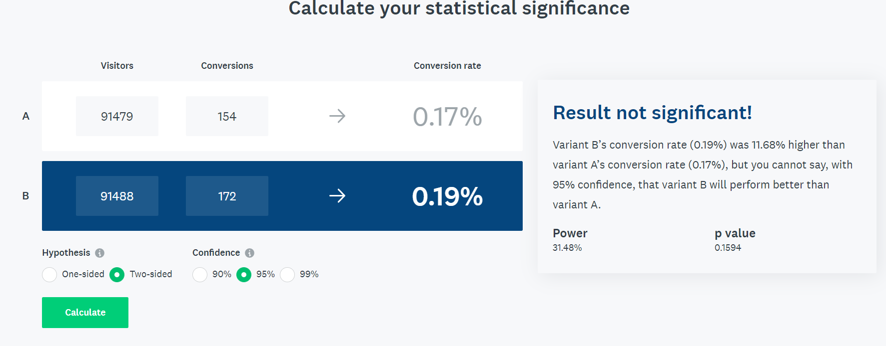
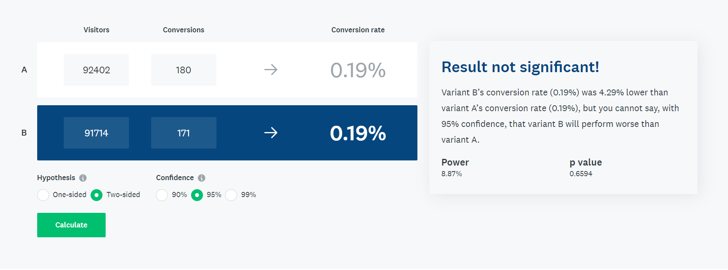
Calculators for Experiments
Experiment 1 and Control (1st image) , Exp 2 and 3 (Below)

Slide 10
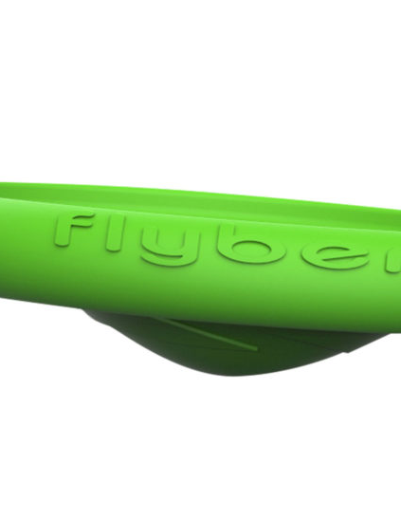
Step 2
Funnel & Cohort Analyses

Slide 11
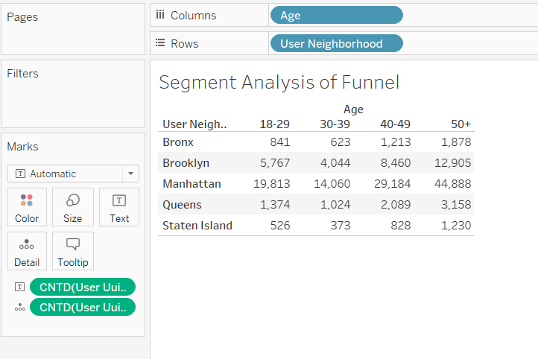
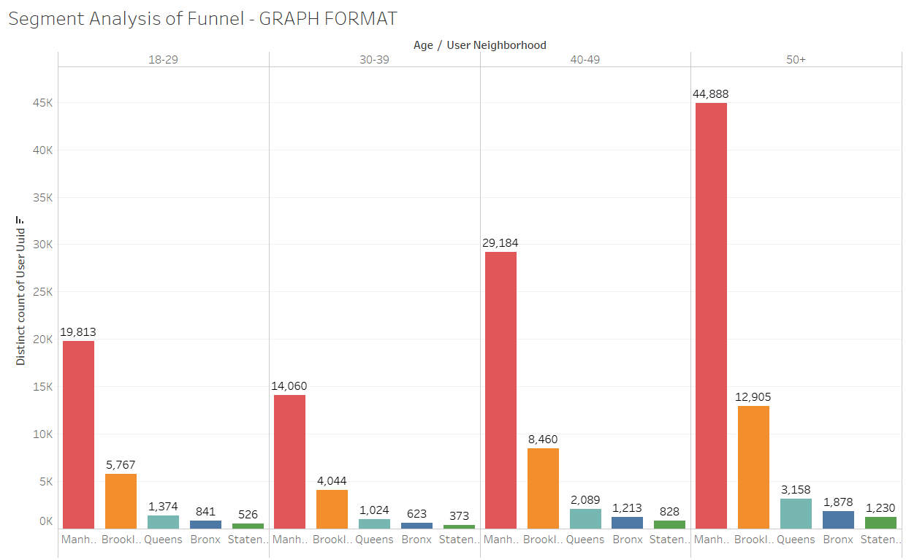
User Funnel
Identifying the different stages the user funnel
Based on the event types in the data provided, list the 3 or more steps a user can take from opening the app to final booking of a ride
Provide a graph showing the funnel from step to step, including drop off rates.

Slide 12
User Segments
Identify 2 demographic attributes present in the data that allow for segment analysis
For each demographic attribute, provide the number of users in each segment group
For each demographic attribute, identify the segment group with the largest number of users

Slide 13
User Segments: Further Explanations
Using the Dataviz presented above, Manhattan had the most number of users, totalling 107,945 users.
(Manhattan)The 50+ age group was the most active with 44,888, followed by the 40 to 49 with 29,184 users
(Manhattan) the least amount of users were in the 30 to 39 with only 14,060 users.
Staten Island had the least amount of users. Totalling only 2,957 users. The 50+ age group had the highest with 1,230. The age group 30 to 39 had the least number of users with 373.
The 50 + age group had the highest users with 64,059
The 40 to 49 age group had 41,774 users
The 30 to 39 age group had 20,124 users
The 18 to 29 age group had 28,321 users

Slide 14
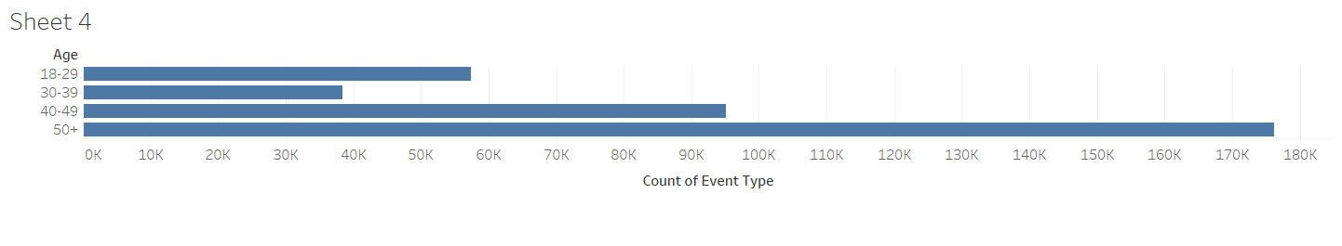
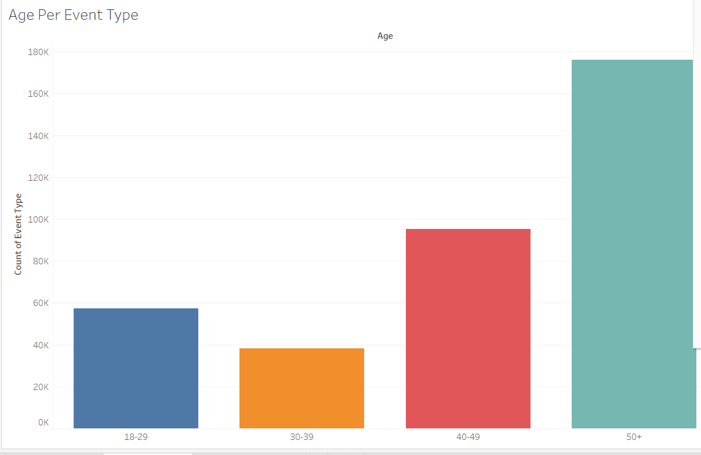
Segment Analysis of Funnel
Identify Opportunities for Improvement
Perform a funnel analysis by segment for all identified demographic attributes and describe the results
Initial Visualization:

Slide 15
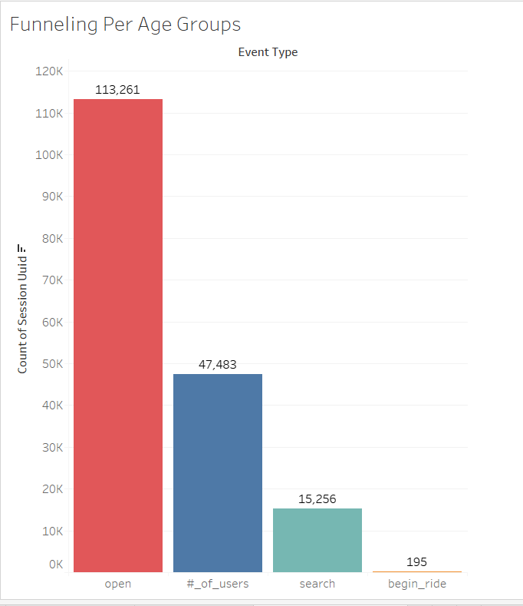
Segment Analysis of Funnel: 50 + years
Drop off rate would be: open_app to #_of_users will be (47483 - 113261)/113261 = -.5807 or -.60
#_of_users to search will be (15,256 - 47,483)/15,256 = -2.11
From search to begin_ride = (195 -15,256)/15,256 = - .98

Slide 16
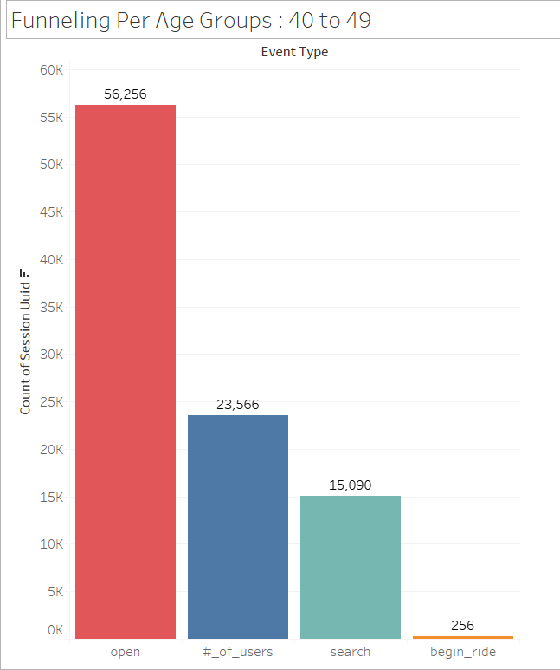
Segment Analysis of Funnel: 40 to 49
Drop off rate would be: open_app to #_of_users will be (23,566 – 56,256)/56,256 = -.5810 or -.60
#_of_users to search will be (15,090 - 23,566)/23,566 = - 0.36
From search to begin_ride = (256 -15,090)/15,090 = - .98

Slide 17
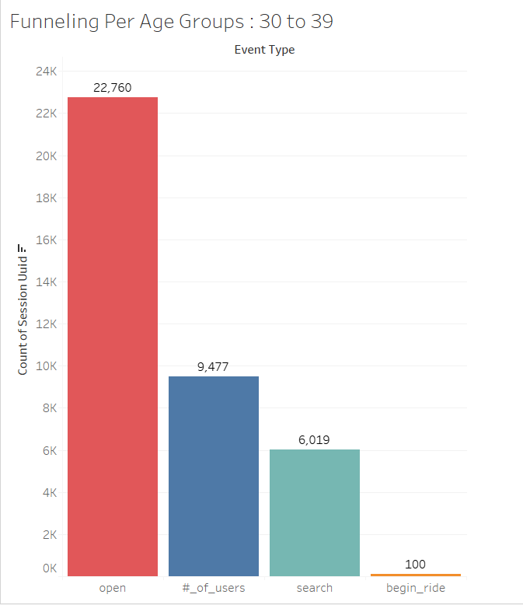
Segment Analysis of Funnel: 30 to 39
Drop off rate would be: open_app to #_of_users will be (9,477 – 22,760)/ 22,760 = -.5810 or -.60
#_of_users to search will be (6,019 – 9,477)/ 9,477 = - 0.36
From search to begin_ride = (100 – 6,019)/6,019 = - .98

Slide 18

Segment Analysis of Funnel: 18 to 29
Drop off rate would be: open_app to #_of_users will be (14,222 – 33,878)/ 33,878 = -.5810 or -.60
#_of_users to search will be (9,138 – 14,222)/ 14,222 = - 0.36
From search to begin_ride = (126 – 9,138)/9,138 = - .98

Slide 19
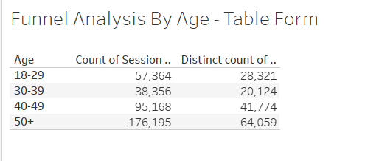
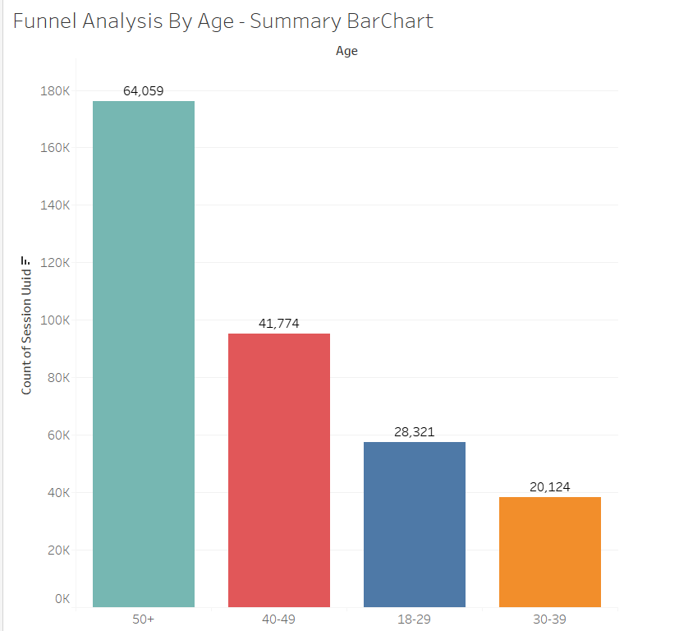
SUMMARIZED FORMAT: Segment Analysis of Funnels

Slide 20
Segment Analysis of Funnel: Continuation
If underperformance for a segment in an attribute is identified, add a visual showing the average funnel conversion by segment group for that demographic
There is definitely a group that has been underperforming. This is the demographic: age 30 to 39. This is extremely unlikely since this group also has ‘needs, activities & daily rituals’ which are somewhat similar or has crossed paths with the other age groups.

Slide 21
Step 3
Hypothesis & Next Steps

Slide 22
Review Qualitative Data
Read user interviews to understand “why” any funnel under-performance seen in Step 2 might occur
List your hypothesis for what customer need is being under-served
Provide 3 or more quotes as evidence for this hypothesis
Based on the quantitative data (as shown by graphs) and the qualitative data (as yielded by the user interviews), 2 age groups suffered ‘under performance. These are the 18 to 29 and the 30 to 39.
There were 3 users that were interviewed. Their specific lifestyles & backgrounds were the main reason why they never used Flyber as much as the other groups.
The ‘Trust Fund’ kid (25 yrs) only uses our service once every 2 months. The ‘Influencer’ (22 yrs) uses it 1x weekly. The 39 year old Real Estate agent uses it 3+ times weekly, but mentioned he’d use a taxi or uber to save money if need be.

Slide 23
Qualitative Data: ‘Quotes from users’
“My family has a private jet, so I only use Flyber when I need to get around in the city. Sometimes my friends and I take limousines ..or I have 3 personal cars I can use for joy rides.”
- Fahim Bourke , ‘Trust Fund Kid’
“If the timing isn't different, I'll take a taxi or uber to save money. “
Keelan Flores , ‘Real Estate Agent’
“Sponsors often pay for me to use their vehicles or set up transportation for me when visiting their restaurants or events.”
- Pharell Campos , ‘Influencer’

Slide 24
Suggested Features & Experimentation Plan
Share your hypothesis using the following format: We believe that both age ranges 18 to 29 and 30 to 39 both under-served Because our marketing campaigns were not properly targeted for these 2 age groups. And that by having a more solid, robust & focused market campaigns, with highly specific audiences for ages 18 to 29 AND 30 to 39 we will see much better results in 3 to 6 weeks. We will properly utilize both Google Ads & FB Ads for these groups. Ocassionaly , we may utilize YouTube Ads and maybe Instagram marketing.
I am also hypoethsizing that the lack of ‘usage incenctives’ by reaching a certain number of rides is a huge factor. Similar to Uber & Lyft, we should be having incentives on ride usage & frequency.
List any additional metrics that would be helpful to collect from your suggested features
* This would be dependent on both qualitative & quantitative data. At first, I would launch a quick qualitative survey that would gauge the lifestyles of each age groups. Also, I would list a set of possible features that users (per age group) would want Flyber App to have.

Slide 25
Suggested Features & Experimentation Plan
Suggest 2 or more features that would match your hypothesis and determine a plan for multivariate testing, including describing the control and experimental conditions
Feature 1: There is no specific incentive when users reach a certain number of rides. For example, Uber and Lyft gives huge discounts when a passenger has reached a certain number of rides in a month or quarter. This would be a feature that we should focus, especially on these 2 under-served age groups.
Feature 2: There should be an auto refund if ride was cancelled by user within the first 4 or 5 minutes. Also, there should be an option to ‘deny’ a wait time charge if a driver arrives more than 4 minutes prior to a scheduled ride (this is based on my personal experience with Uber since 2016)
Determine who should be exposed to the experimental changes
I would focus on both the 18 to 29 and 30 to 39 age range. As I have mentioned in my previous slide, even our entire marketing campaigns in specific platforms would also be focused. Even within these age groups, there are ‘sub groups’ ( hobbies, family status, social status, careers, schools, etc).

Slide 26
Appendix
Raw Data

Slide 27
Additional Info
The only supporting documents were the visualizations that I have. For this project, I mainly used Tableau public only.
Here is the link to my Tableau Public Account:
https://public.tableau.com/profile/frederick.zoreta.first#!/
Graph Specific to this project:
https://public.tableau.com/profile/frederick.zoreta.first#!/vizhome/MultiVariate_Proj4/SegmentAnalysisofFunnel-GRAPHFORMAT

